Slide 1
Week 19 – AP Macroeconomics

Slide 2
Money Supply Growth and Inflation – Quantity Theory of Money

Slide 3
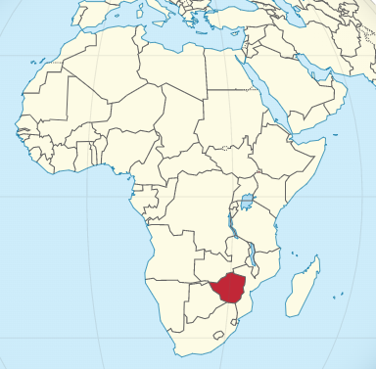

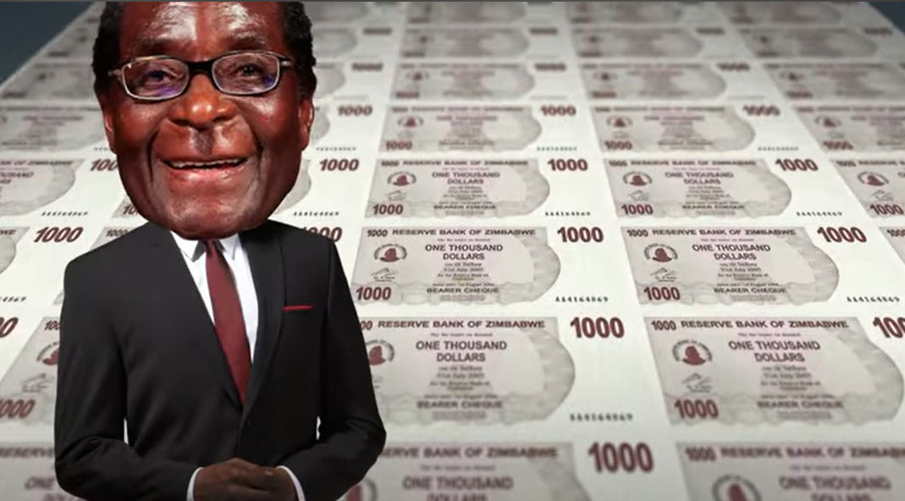
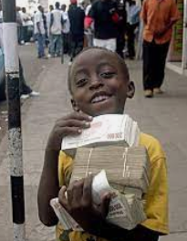
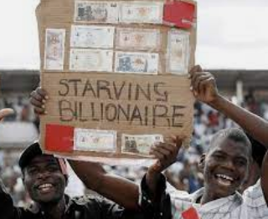

Zimbabwe Hyperinflation
Have you ever dreamed of being a billionaire?
For most people living in Zimbabwe this was a reality under the presidency of Robert Mugabe – the average person was a billionaire.
But were the people happy about this?
No, unfortunately this was driven by massive inflation – hyper inflation.
https://youtu.be/78-BlZXm7wA?t=40

Slide 4

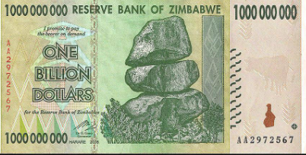

Money Supply and Inflation
Summary
Money supply increases that are greater than the increase in production will inevitably lead to inflation.
Inflation occurs when the money supply increases too quickly for a sustained period.
This effect is particularly apparent in poorly managed countries such as Zimbabwe and Venezuela where government money printing (creating new money) has lead to hyperinflation.
Inflation was so bad in Zimbabwe that the US dollar was temporarily adopted as the nation’s currency because its currency became worthless.
Note: Printing money isn’t a problem, if there are more goods and services in the economy, but if more and more money chases the same number of goods, then inflation is inevitable.
(Inflation is always caused by money supply.)
Milton Friedman (above) is a highly influential economist of the Chicago School of Economics and is synonymous with Monetarism which focused on topics of money supply.
Among his contributions to economics is the Quantity Theory of Money.
Too much money printing
Inflation

Slide 5
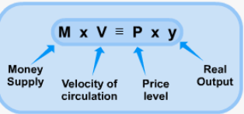
Quantity Theory of Money - Overview
Nominal GDP
The quantity theory of money is an equation that equates the movement of all money in the economy and Nominal GDP.
The amount of money in the economy
Depending on the type of money we are looking at this could mean M1 or M2 for example
Y, Real Output
How often $1 dollar changes hands in a year.
Shows the number amount of economic activity.
Price of all goods and services.
Summary
Quantity theory of money: MV = PY

Slide 6
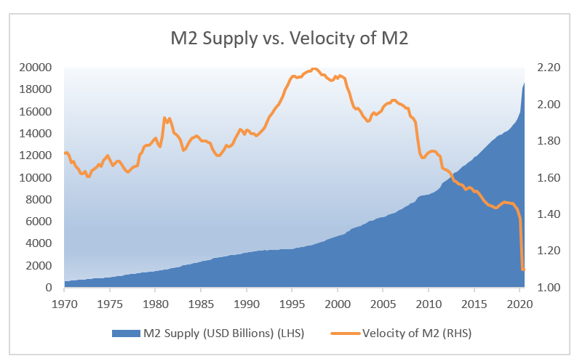
Velocity of Money
Summary
The velocity of money is the amount of times a dollar will be used in a transaction in a year.
How many times a dollar is used in a transaction in a given year
Remember from our study of the spending multiplier, that spending will lead to more spending. Therefore, a dollar will change hands multiple times in a given year.
This is an indicator of the amount of economic activity that occurs in the economy.
This velocity is relatively stable but we can see that it can vary markedly over long periods of time or during large events such as Covid 19

Slide 7
What is the quantity theory of money equation?
MV = PY
What do each of the variables stand for?
M = money supply
V = velocity of money
P = price level
Y = real GDP

Slide 8
Quantity Theory of Money – Values for M, V, P and Y
Stability of the values:
Stable:
Real Output is considered somewhat stable
Velocity is somewhat stable
Variable:
Money supply and price level are more variable.
Variable
Stable
Stable
Variable
Consequences of the values
The quantity theory of money assumes that Price Level and Velocity of money are relatively stable and that ↑ money supply M will inevitably lead to ↑ Price Level P.
Stated another way, this is why, when we put too much money in circulation, there will be inflation.
Summary
Quantity theory of money: MV = PY
We assume V and Y are stable, therefore ↑ Money Supply→ ↑ Price Level.

Slide 9
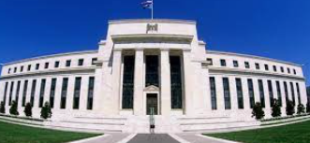
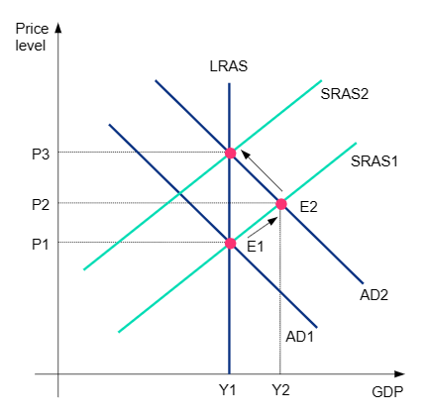

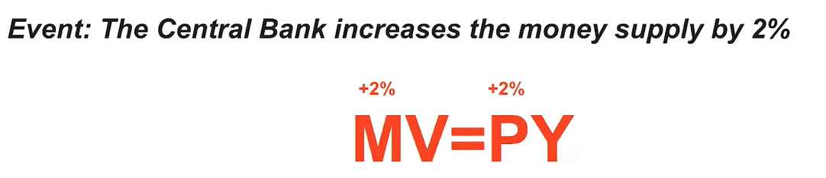
Consequences of Money Printing
Inflation occurs when the money supply increases/decreases too quickly for a sustained period.
Increases prices
Increases output for a short while
but eventually wages increase, potentially causing a spiral of inflation.
Note: Nowadays a lot of so called money printing is actually done electronically.
Increase in money supply will increase the price level by the same amount.

Slide 10
Which variables in the quantity theory of money do we assume to be stable?
Velocity of money V
Real Output Y
Based on this assumption, what does this mean if we increase the money supply M?
Because MV = PY, and V and Y are stable, we assume that ↑M→↑P
Ie. Increasing money supply eventually leads to inflation

Slide 11
Monetary Policy in the Long Run
So far we have looked at the effects of MP and FP in the short run.
From our study of the quantity theory of money, one important conclusion can be made about increasing money supply in the long run – that the effect on output is zero!

Slide 12
Long Run Consequences of MP
It has no effect on output!
Why? Because once price levels of all things (including goods and services, resources and flexible wages) adjust, the economy will return to Y_{P}
Therefore, any change to money supply, in the long run, the effect will be neutral. This is what is referred to as money neutrality.
Summary
MP has no effect on Yp in the long run. (Note: Only the things related to human capital, capital, technology etc. influences this)

Slide 13
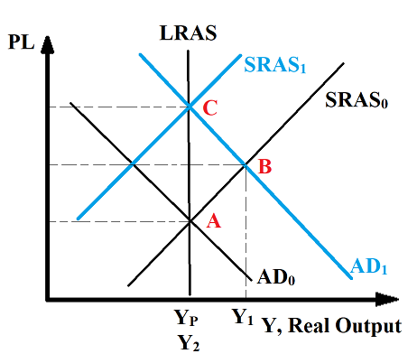
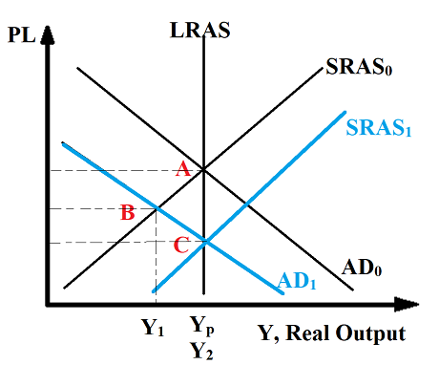

Money Neutrality
Summary
The quantity theory of money states that money supply has no effect on output in the long run ie. Money Neutrality.
Can be explained using:
Quantity Theory of Money
MV = PY
From the equation, we can see that any increase in Money Supply will simply cause an increase in price level, because Y and Money velocity are considered relatively stable.
Long Run Result of ↑MS
Increases prices, which eventually lead to wage increases, decreasing SRAS and returning us back to Y_{F}
Therefore, changes to the money supply have no long term change to real output
AD/AS Graph
Our study of the AD/AS graph also show us that when all prices adjust (wages and resource costs as well as goods and services), the economy will always return back to Y_{P} with a higher or lower price level.
Conclusion:
Ultimately, long run output is determined by the quality and quantity of resources and technology available in the economy.

Slide 14
According to the Quantity Theory of money, what will happen when we increase the money supply by 2%?
The price level will increase by 2% because we assume Velocity and Y is stable.
The quantity theory of money is based in the long run or short run?
The long run

Slide 15
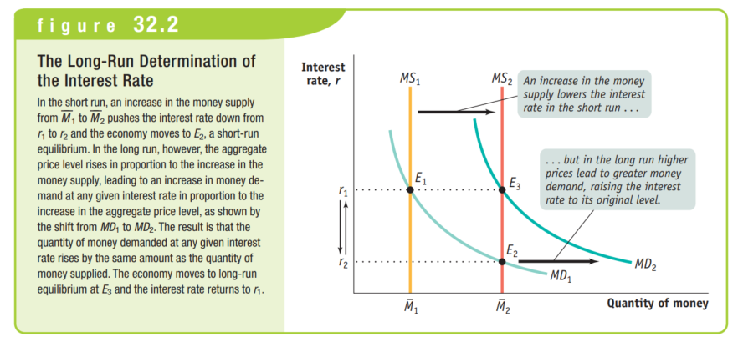
Money Supply and Inflation – Money Market
Once the money supply is increased through expansionary FP, the interest rate falls.
However, once the price level increases, MD will increase also, which will return interest rates back to the previous level.
Summary
Short Run: Expansionary MP →↓IR↑AD – MP changes output
Long Run: ↑AD→↑PL→↑MD→↑IR – MP doesn’t change output

Slide 16
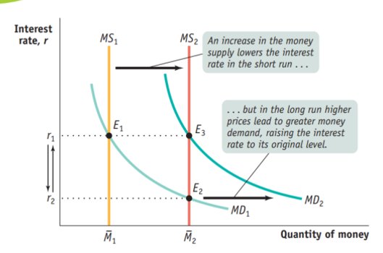
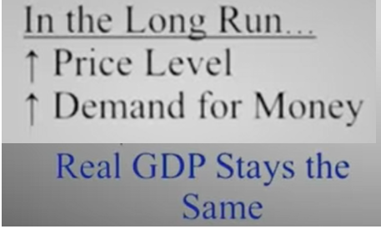
Long Run Money Market

Slide 17
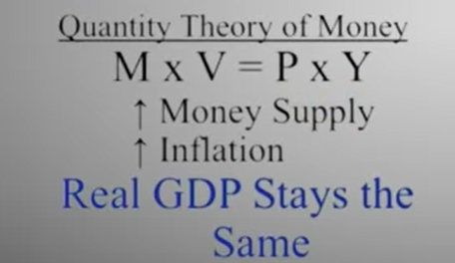
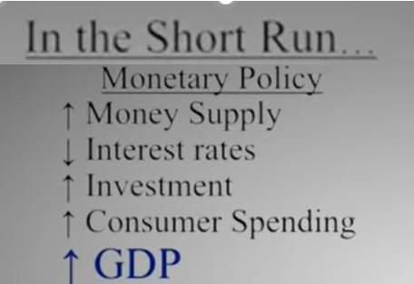
Comparing Short Run vs Long Run
Long Run
Short Run
The idea that MP has no effect in the long run seems to contradict our previous study, however we should remember that the economy behaves differently in the long run and short run.
Money Market
Summary
Short run: MP increases GDP.
Long Run: MP has no effect on GDP.

Slide 18
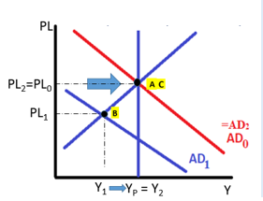
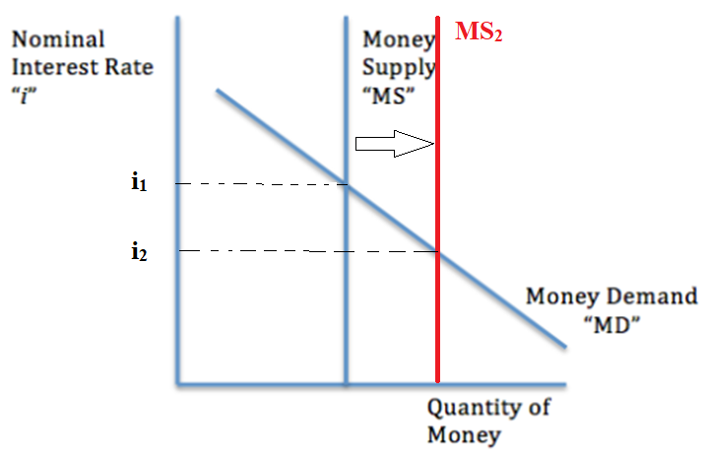
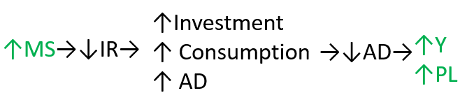
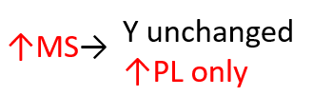
Quantity Theory of Money Summary
Short Run
Long Run
Variable
Stable
Stable
Variable
Increasing money supply is expansionary monetary policy that can increase output in the short run.
Increasing money supply will only lead to inflation.

Slide 19
What is the effect of expansionary MP, increasing MS, in the short run?
Decrease of interest rates -> increase consumption, investment -> increase AD -> increase output
What is the effect of expansionary MP, increasing MS, in the long run?
No effect, just an increase of the price level.

Slide 20
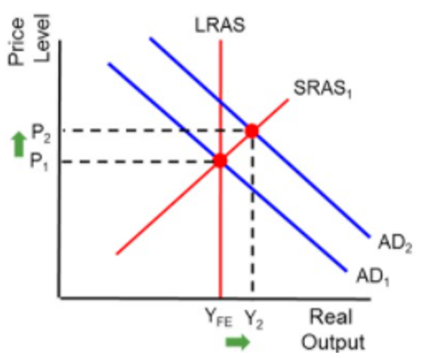
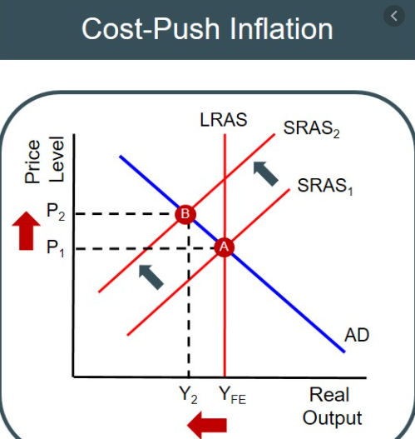
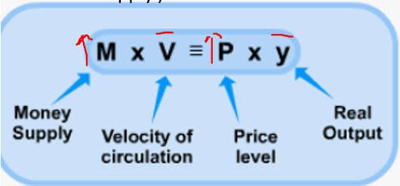
3 Causes of Inflation
To remember if it’s cost push, or cost pull inflation… remember that cost and push both have an ‘s’.
There are certain questions that will ask about ‘demand pull’ and ‘cost push’ inflation in particular. You should understand these causes of inflation.
Demand Pull Inflation
With an increase in AD caused by an increase in any of the components of AD (C+I+G+X-M), the equilibrium price level will be higher.
Eg. Prices in large cities are higher because people are more motivated to move there and will lead to higher AD.
Cost Push Inflation
A decrease in aggregate supply (Eg. Increased resource costs and supply costs)
This causes lower output and higher prices! This is also called stagflation = stagnation (no growth) + inflation
Eg.1970s US stagflation
In the 1970s the OPEC countries, for political reasons, reduced their oil supply to many countries including the United States. Because oil is such an important resource, it affected the supply of many businesses. This caused the SRAS (or arguably the LRAS) to shift to the left, causing an increase in the price level.
Quantity Theory of Money Inflation
According to some economists (Monetarism), the leading cause of inflation is always increases in the money supply.
This is effect is particularly apparent in poorly managed countries such as Zimbabwe and Venezuela where government money printing (creating new money) has lead to hyperinflation.
Inflation was so bad in Zimbabwe that the US dollar was temporarily adopted as the nation’s currency because its currency became worthless.

Slide 21
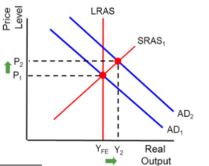
Causes of Inflation Review Question
What are three causes of inflation? Use graphs or equations to show the effect
Demand Pull, Cost Push, Inc rease in Money Supply

Slide 22
Exercises

Slide 24
5.4 Government Deficits and National Debt

Slide 25
Review: Government Budgets

Slide 26


Government Budget
Summary
Government budgets are the plan for spending and tax and can be balanced, in deficit or in surplus.
The government budget is a plan for the amount of tax and government expenditure.
How does a government pay for Government Spending (G) and government transfers?
One of the main ways is through raising tax. (Income tax, Consumption tax, Corporate tax, import tax etc.)
National Savings/Public Savings will be affected by the government budget. (Note: Negative Public savings = Public debt)
The government budget is a plan for government expenditure and tax and can fall into three categories:
Balanced Budget: Tax = Government Expenditure
National Savings/Debt will stay the same.
Budget Deficit: Tax < Government Expenditure
National Savings will decrease/National debt will increase.
Budget Surplus: Tax > Government Expenditure
National Savings will increase/National debt will decrease.
The government will have a certain targets for the proportion of spending on different parts of the economy.

Slide 27
What is the government budget?
A plan for how much the government spends and plans to raise in tax.
What are three types of government budget that can occur?
Balanced Budget: Tax = Government Expenditure
Budget Deficit: Tax < Government Expenditure
Budget Surplus: Tax > Government Expenditure

Slide 28
Government Budget Deficits/Surpluses and Fiscal Policy
Summary
Budget Deficit – tends to go with Expansionary Fiscal Policy
Budget Surplus – tends to go with Contractionary Fiscal Policy
Associated with:
The government budget is a plan for government expenditure and tax and can fall into three categories:
Balanced Budget: Tax = Government Expenditure
Budget Deficit: Tax < Government Expenditure
Budget Surplus: Tax > Government Expenditure
Neither Expansionary or Contractionary Fiscal Policy
Expansionary Fiscal Policy
Contractionary Fiscal Policy

Slide 29
If a government spends more than it taxes, what kind of budget is this?
Budget deficit
This is associated with what kind of fiscal policy? Expansionary or Contractionary?
Expansionary because it indicates high government spending (expansionary) and low tax (also expansionary)

Slide 30



National Savings, Public Savings, Private Savings
Private savings = savings from firms and households
Public Savings = Government savings
National Savings = Public Savings + Private Savings
Note: Sometimes National Savings is used to mean Public Savings

Slide 31
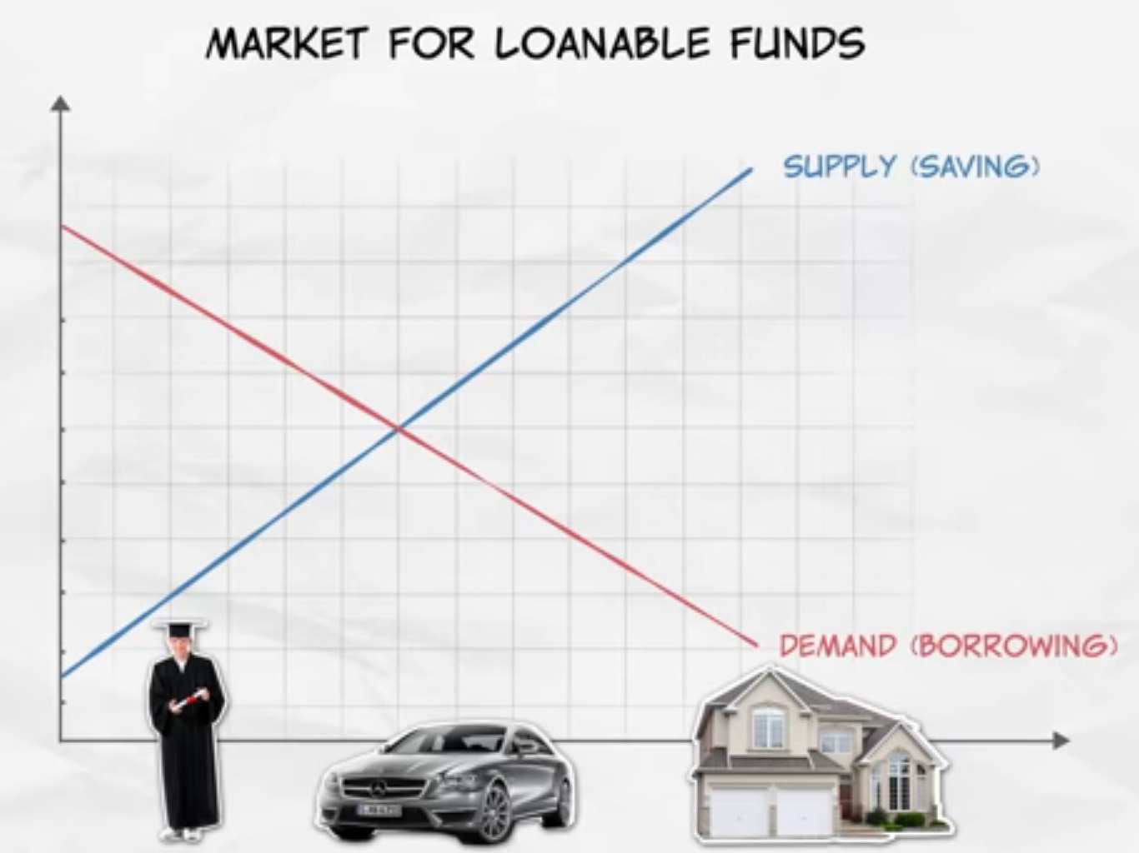
Budget Summary
 | +/- | Definition | Type of Fiscal Policy | Government Borrowing/Saving | Effect on Loanable Funds Market
Balanced Budget |  | Tax = Government Expenditure | Neutral FP | Borrowing/saving remains the same | D_{LF} unchanged S_{LF} unchanged
Budget Deficit | - | Tax < Government Expenditure | Expansionary FP (↓Tax↑Gov expenditure) | Borrowing increases/ Saving decreases | D_{LF} increases S_{LF} decreases
Budget Surplus | + | Tax > Government Expenditure | Contractionary FP(↑Tax↓Gov expenditure) | Borrowing decreases/savings increases | D_{LF} decreases S_{LF} increases

Slide 32
When the government increases government spending? What is the effect on the loanable funds market?
↑G → ↑Budget Deficit (or ↓Budget Surplus) →gov borrowing → D_{LF} (or↓S_{LF})

Slide 33
Debt vs Deficit, Savings vs Surplus
Debt is negative and so is deficit. Savings is positive and so is surplus.
So what is the difference between the two?

Slide 34


Public Debt vs Public Savings
Public Debt = negative amount
The government has borrowed money overall over a period of time.
Public debt can also be thought of as ‘negative savings’
Public Savings = positive amount
The government has saved money overall over a period of time

Slide 35
What is the difference between public savings and national savings?
Public savings = government savings
National savings = public + private savings = government savings + household/firm savings
Public debt means that the government has saved over a period of time or has borrowed over a period of time?
Borrowed. The amount that the government has saved is negative.

Slide 36



Stock vs Flow
Summary
Stock = total amount
Flow = change
Flow
= change of water (positive)
One way to describe the amount of something vs the change of that amount is to use the terms ‘stock’ and ‘flow’.
Stock = the total accumulated amount of something
Flow = the change in the total amount.
If we use the analogy of a bathtub, we can see that the water already in the bathtub is the stock and the change of water (positive or negative) is the flow.
Stock
= total water in bath tub
Flow
= change of water (negative)

Slide 37
If you have 5kg of rice and you eat 1kg of rice per week, which is the stock and which is the flow?
5kg rice = stock, 1kg rice per week = flow
If the government has $50 million of public debt and they have a budget surplus of $10 million. Which is the stock and which is the flow?
$50 million debt = stock, $10 million = flow
If the government has $50 million of public savings and they have a budget surplus of $10 million. Which is the stock and which is the flow?
$50 million savings = stock, $10 million = flow

Slide 38
Debt vs Deficit
What is the relationship between national debt and the budget deficit?
Budget deficit = the amount for one year
Public debt = the total accumulated amount over the years
Flow
Summary
Debt = the total accumulated amount, a ‘stock’
Deficit = the amount for just the year, a ‘flow’
Stock
Analogies to explain stock vs flow
Water in a bath
Budget deficit (flow) = water draining out of a bath at 1L/min
National Savings (stock) = the total amount of water in the bathtub
A car’s speed and acceleration
Budget deficit (flow) = the change in speed of the car to 5km/h slower
National Savings (stock) = the current speed of the car
We call the accumulated amount a ‘stock’ and the change in that amount a ‘flow’.

Slide 39
Surplus vs Savings
What is the relationship between national debt and the budget deficit?
Budget Surplus = the amount for one year
Public Savings = the total accumulated over multiple years
Flow
Summary
Savings = the total accumulated amount
Surplus = the amount for just the year
Stock
We call the accumulated amount a ‘stock’ and the change in that amount a ‘flow’.

Slide 40
Categorize the following terms as ‘total accumulation/stock’ or ‘the change in one year/flow’
Public debt
Budget deficit
Public savings
Budget surplus
Balanced budget
If the government has a budget deficit, what happens to public savings?
It decreases. Eg. If the public savings = 1 million, a budget deficit will decrease it.
If the government has a budget deficit, what happens to public debt?
The debt would increase. Eg. If the public debt = 1 million (a negative number) then it will increase, become more negative.
Total accumulation/stock
The change in one year/flow
Total accumulation/stock
The change in one year/flow
The change in one year/flow, but technically this is no change.

Slide 41
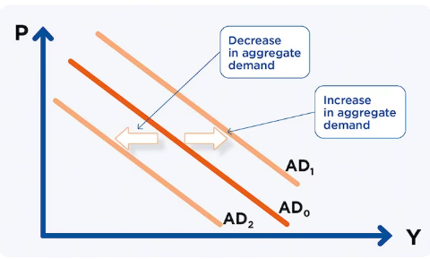
Budgets and their effects - Summary
 | +/- | Definition | Type of Fiscal Policy | Government Borrowing/Saving | Effect on Loanable Funds Market | Effect on Public Savings (and National Savings) | Effect on Public Debt (and National Debt)
Balanced Budget |  | Tax = Government Expenditure | Neutral FP | Borrowing/saving remains the same | D_{LF} unchanged S_{LF} unchanged | No Effect | No Effect
Budget Deficit | - | Tax < Government Expenditure | Expansionary FP (↓Tax↑Gov expenditure) | Borrowing increases/ Saving decreases | D_{LF} increases S_{LF} decreases | Decrease (Savings reduced) | Increase (Debt increased)
Budget Surplus | + | Tax > Government Expenditure | Contractionary FP(↑Tax↓Gov expenditure) | Borrowing decreases/savings increases | D_{LF} decreases S_{LF} increases | Increase (Savings increased) | Decrease (Debt decreased)

Slide 42
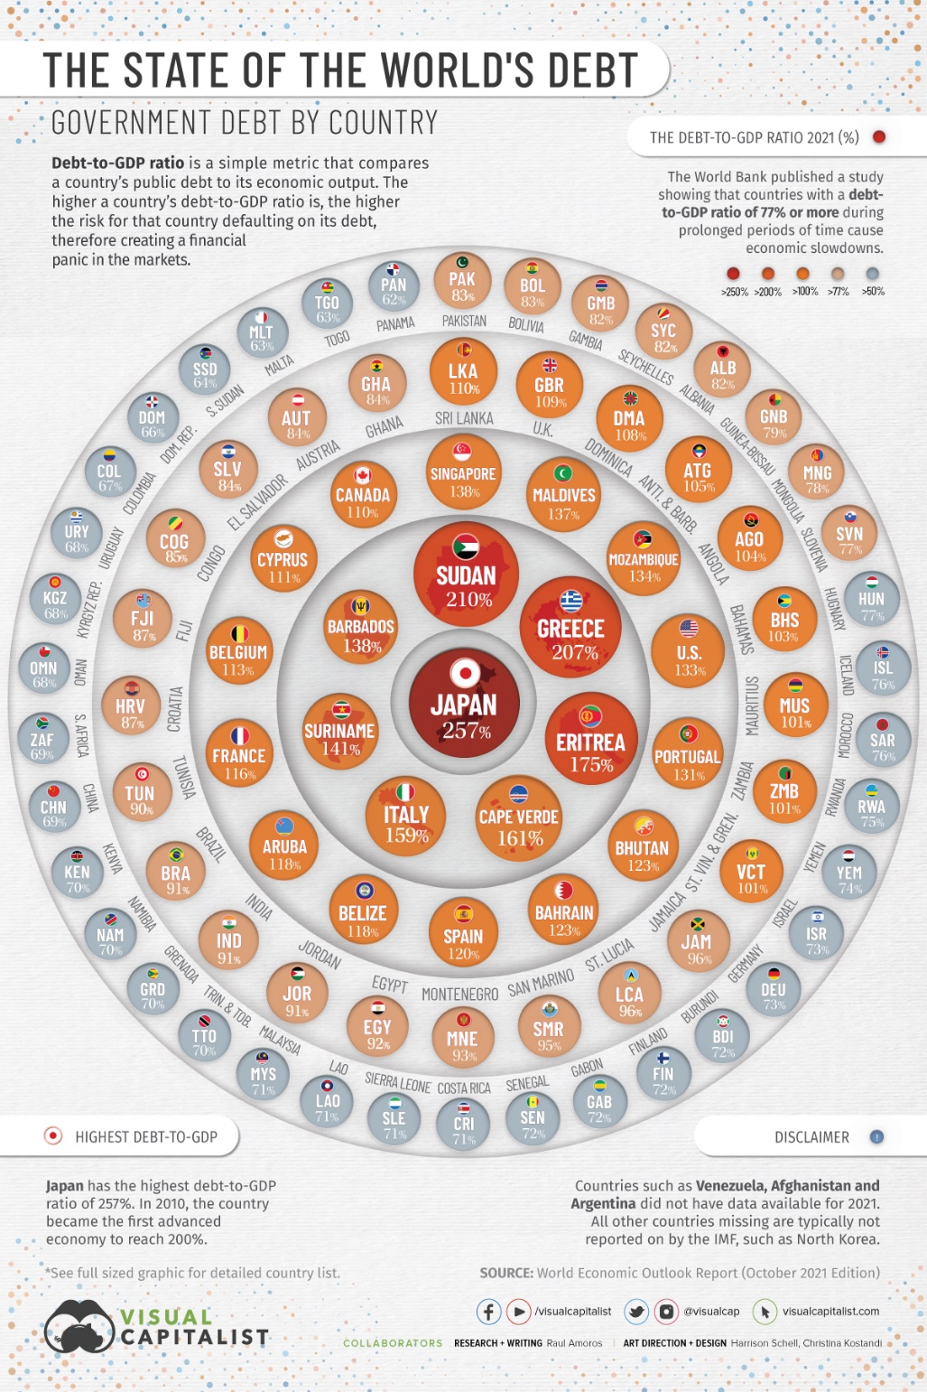
Government Debts
The US Government is famous for having a huge amount of government debt.
At this point in time, it is approximately 30 trillion dollars. This is 1.5 times the GDP of the US!
At this website, you can see the increase in the debt in real time. https://www.usdebtclock.org/
However, the US doesn’t have the worst debt in the world in comparison to the country’s GDP. There are actually several countries that are faring worse including Japan and Greece.
Summary
The US government debt is huge but relative to the GDP it is not the worst debt in world compared to some other countries.

Slide 43
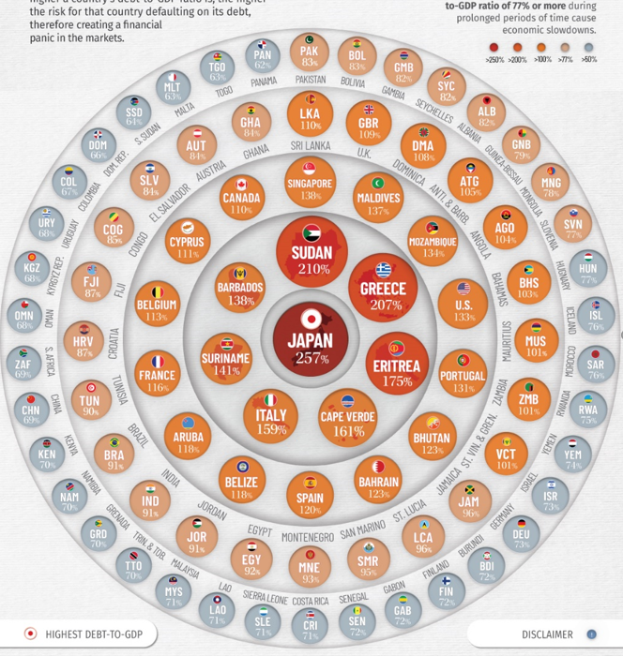

Slide 44
5.5 Crowding Out
We have talked about Fiscal Policy in previous classes.
There is one ‘issue’ with Fiscal Policy that we did not previously covered, which we can now analyse following our coverage of the loanable funds market.

Slide 45
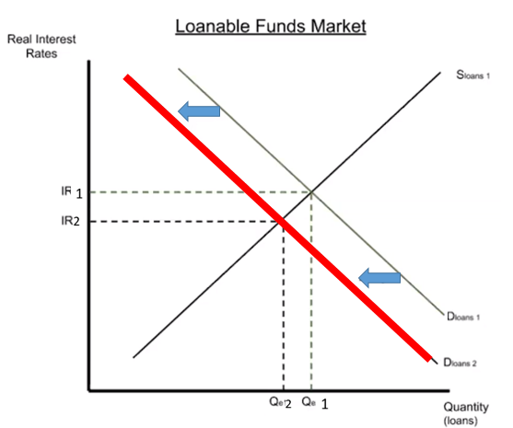
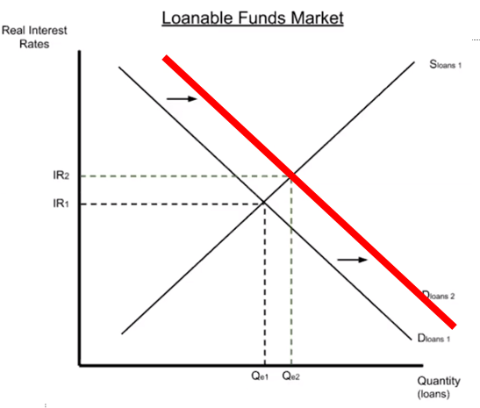
 | +/- | Definition | Effect on Loanable Funds Market | Association to Fiscal Policy
Balanced Budget |  | Tax = Government Expenditure | No Effect | No connection
Budget Deficit | - | Tax < Government Expenditure | Increase D_{LF} (Gov borrowing) | Associated with Expansionary FP
Budget Surplus | + | Tax > Government Expenditure | Decrease D_{LF} (less Gov borrowing) | Associated with Contractionary FP

Slide 46
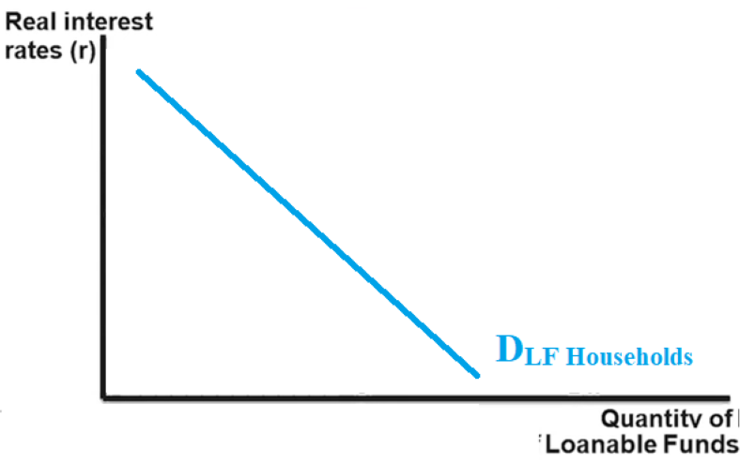
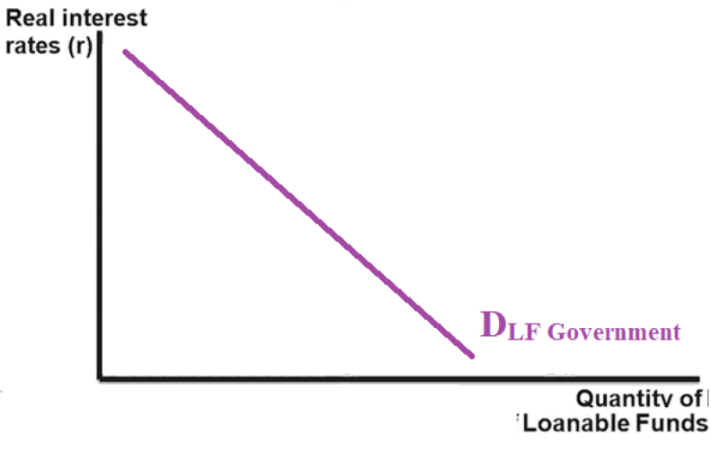
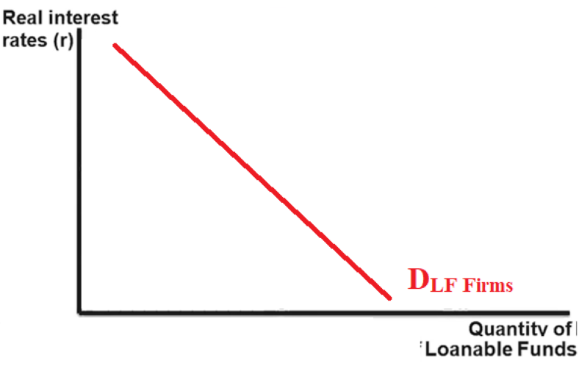
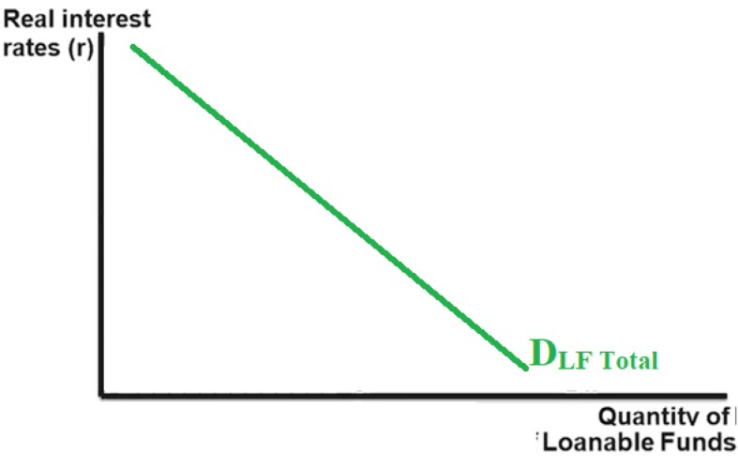
Loanable Funds Market Demand
Public Demand
While we have focused on the borrowing of households and firms, Government also often borrows money.
Recall that D_{LF} comes from borrowing from:
Households
Firms
Government
So if we divided the D_{LF} into D_{LF} _{Private} and D_{LF} _{Government} it would appear like this:
Private Demand
Summary
Demand for loanable funds is made up of private demand and government demand.

Slide 47
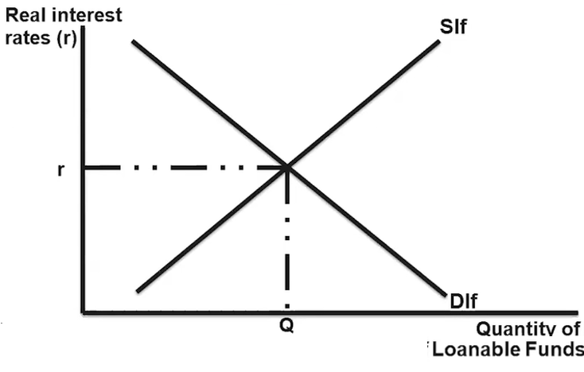
Expansionary FP - Loanable Funds Market
Expansionary FP means tax < government expenditure -> more of a budget deficit.
Government budget deficit spending leads to more borrowing.
Government borrowing can be seen in the loanable funds market.
D_{LF} increases

Slide 48
Loanable Funds Market Demand
r₂
r₁
Q₂
Q₁
Q₂
Q₁
Q₁
Q₂
Because the government D_{LF} has increased, this pushes up the IR, which decreases the Q_{DLF} for both households and especially firms.
(This can happen in many situations! Eg. You want to buy concert tickets but because they are so popular the price goes up which makes it more expensive for you.)
r₂
Summary
When government borrows more, they push up the IR which leads to lower quantity borrowed by both firms and households.
Less firm borrowing = less investment.
r₁

Slide 49
Analogy – Tickets to a Concert
Old fans
Old fans
New fans
r₂
r₁
Q₂
Q₁
Q₂
Q₁
Q₁
Q₂
All Fans (Old and New)
Because the government D_{LF} has increased, this pushes up the IR, which decreases the Q_{DLF} for both households and especially firms.
(This can happen in many situations! Eg. You want to buy concert tickets but because they are so popular the price goes up which makes it more expensive for you.)
r₂
Higher Ticket Prices
Summary
When there are new fans buying tickets, it makes ALL tickets more expensive, which ‘punishes’ the old fans.
Therefore, old fans will be ‘crowded out’ and buy fewer tickets.
r₁

Slide 50
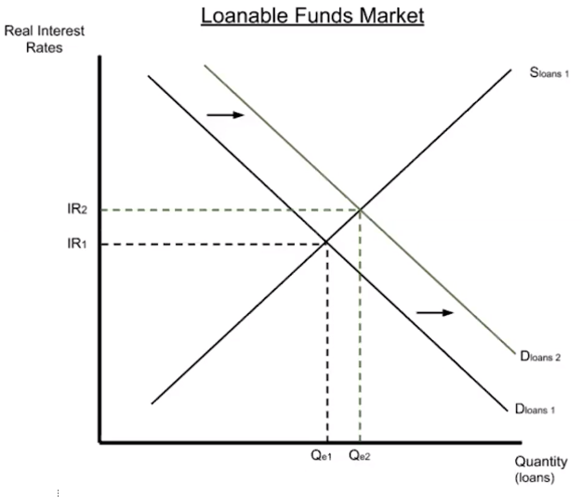
Crowding Out – Loanable Funds Market
Summary
The increase of government borrowing causes an increase in total borrowing but a decrease in private borrowing. This is ‘crowding out’.
Because the D_{LF} has increased, there is an increase in total borrowing. ↑Total borrowing
The difference between D_{LF}1 and D_{LF}2 is due to government. ↑Gov borrowing
However, because of the increase in real interest rate, private borrowing/investment will actually decrease slightly↓
This reduction in private borrowing is what gives ‘crowding out’ its name.

Slide 51
What can be said about firm borrowing and investment when the government increases their borrowing in the loanable funds market?
Increase government demand -> increase IR -> decrease quantity of firm borrowing -> decrease investment

Slide 52
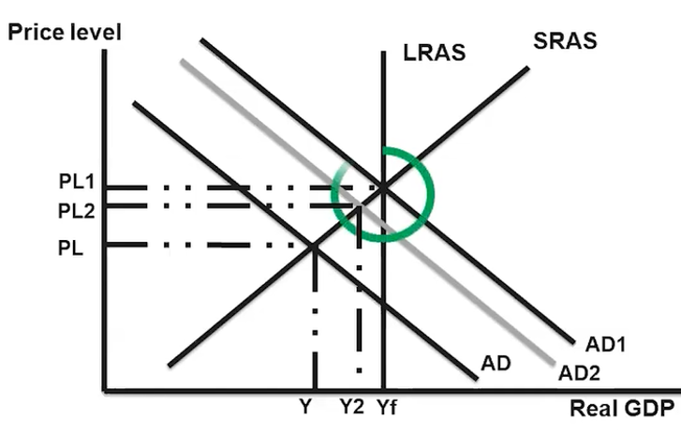
Short Run Crowding Out Effect – AD/AS
Effect of Expansionary FP
(↓taxes, ↑gov spending, ↑gov transfers)
Increases AD from AD to AD₁
Crowding Out Short Run Effect
Crowding out leads to less private investment spending (↓C ↓I)
While G will increase, there will be a reduction in I which will counteract the increase in AD.
This will cause AD₂ rather than AD₁
Expansionary effect with no crowding out
Crowding out effect
Summary
Expansionary FP shifts AD to AD₁ but the effect of crowding out decreases it to AD_{2.}

Slide 53
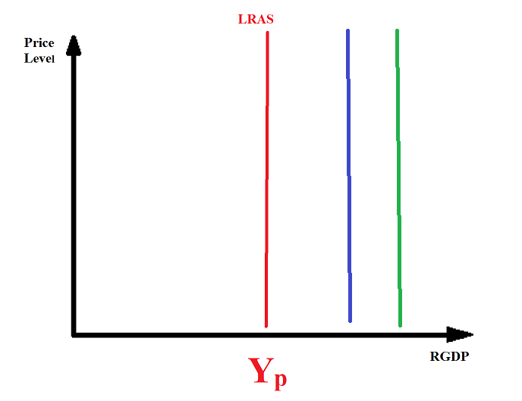
Long Term Effect of Crowding Out
Note: This does not mean growth will be negative, just increasing at a decreasing rate.
Long Term Effects
The increase in deficit spending leads to an increase in the Real Interest Rate, which leads to a decrease in private investment spending
A decrease in investment causes the economic growth rate to slow, because fewer capital goods are being produced relative to the economy's productive capacity.
This can be represented by the LRAS not shifting to the right as much.
LRAS_{crowding out}
LRAS_{no} _{crowding}
Growth (no crowding out)
Growth after crowding out
Less capital goods will lead to lower growth rates.

Slide 54
What is the short run effect of expansionary FP which also has a crowding out effect?
The AD will increase, but the ‘crowding out’ will cause a slight decrease in AD which will partially cancel out the increase.
What is the long run effect of expansionary FP which also has a crowding out effect?
Because of the decrease in private borrowing -> less investment -> fewer capital goods/less improved technology in future periods.
Therefore, lower economic growth.
LRAS will not shift to the right as much.

Slide 55
Crowding Out Summarized
Expansionary FP→↑G↓T→↑Budget Deficit→↑Government borrowing
→↑D_{LF}→↑Real Interest Rate→↓Private Borrowing→↓Investment
SR: ↓Investment →↓AD (but overall still increase AD)
LR: ↓Investment →↓Capital Formation, Technology Advances, Human capital improvements→↓Productivity Growth→↓Economic Growth (↓growth of the LRAS)
Government
Expenditure and borrowing
Crowding Out Definition: “The reduction in private investment spending that is a side effect of government spending financed by government borrowing.”
Private Investment

Slide 56
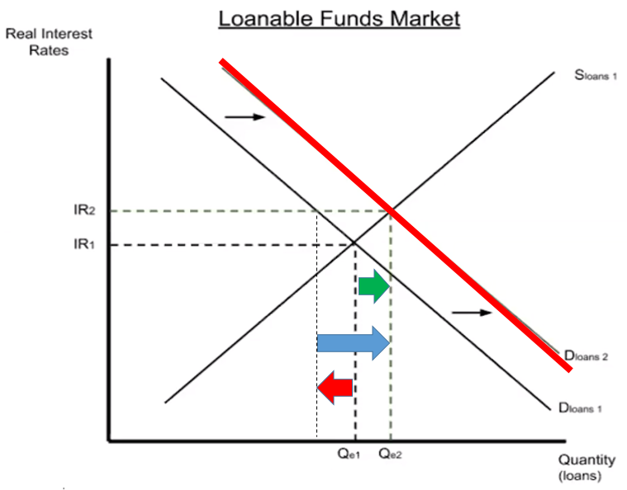
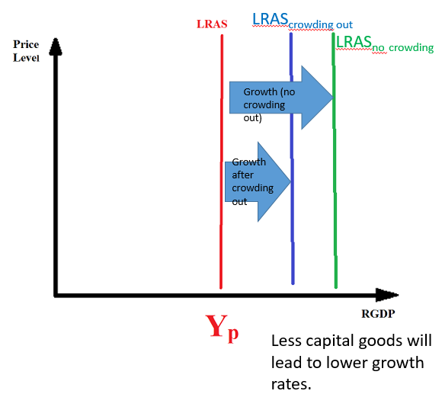
Crowding Out Summary
The governments increase in deficit spending, due to expansionary fiscal policy, causes real interest rates to increase in the loanable funds market.
The higher interest rate leads to less private borrowing because these individuals have been ‘crowded out’ by the government and the resulting higher interest rate.
The lower private investment leads to less creation of capital stock (and also technology improvements from research and development) which results in less economic growth.
(Note: The growth may still be positive, but less positive)
Short Run Effect
Long Run Effect

Slide 57
If the government decreases taxes without making any changes to government spending, what is the effect on the government budget?
Moves toward deficit.
As a result of the change to the budget, what is the effect on demand and supply of the market for loanable funds and interest rate?
The budget deficit leads to more government borrowing which leads to an increase of demand (or a decrease in supply). This causes an increase in the real interest rate?
As a result of the change of the RIR, what is the effect on private borrowing?
Private borrowing will decrease. (This is what we refer to as crowding out)

